Slide 1
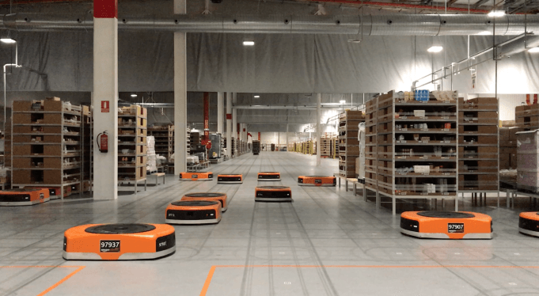
Amazon Robotics machines in a Amazon warehouse
Collision avoidance and coordination for a fleet of robots
Luca Marseglia

Slide 2
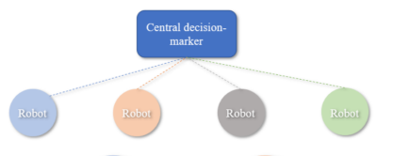
Background: Centralized approaches
A central controller manages the movements of all the robots in the system
Benefit from their global optimality, as the entire system’s configuration is considered while taking decisions
Poorly scalable
Typically used in offline planning scenarios
2024 October | Slide 2

Slide 3

Background: Decentralized approaches
Distribute the responsibility for collision avoidance across the robots
Usually used in real-time applications
Highly scalable
Struggle with sub-optimality
2024 October | Slide 3

Slide 4
Chosen approach: MINLP + GA
The problem will be formulated as a MINLP optimization problem
The optimization problem will be solved using GA
MINLP is suitable for modelling a complex problem that involves both continuous and integer variables as well as nonlinear constraints
GA is suitable for solving multi-dimensional optimization problems without relying on gradient information, because uses a population based approach, as exact gradients can be challenging to compute
Furthermore, is flexible in managing multiple objectives (in this case time and energy)
This approach can offer a good level of optimality compared to online and centralized methods
2024 October | Slide 4

Slide 5

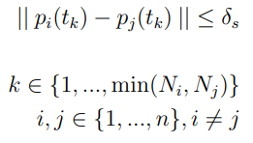
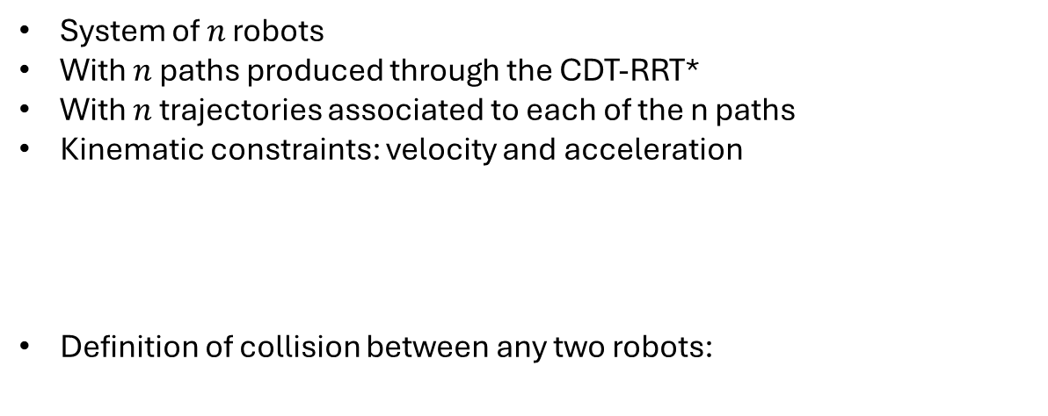
Introduction
System of $n$ robots
With $n$ paths produced through the CDT-RRT*
With $n$ trajectories associated to each of the n paths
Kinematic constraints: velocity and acceleration
Definition of collision between any two robots:
2024 October | Slide 5

Slide 6
Problem statement
The algorithm must ensure that the robots respect the safety margin during their movement by modifying their velocities based on their kinematic constraints.
The optimization must balance multiple objectives, including:
Minimizing total travel time
Minimizing energy consumption
Ensuring a safety margin between the robots during motion
2024 October | Slide 6

Slide 7
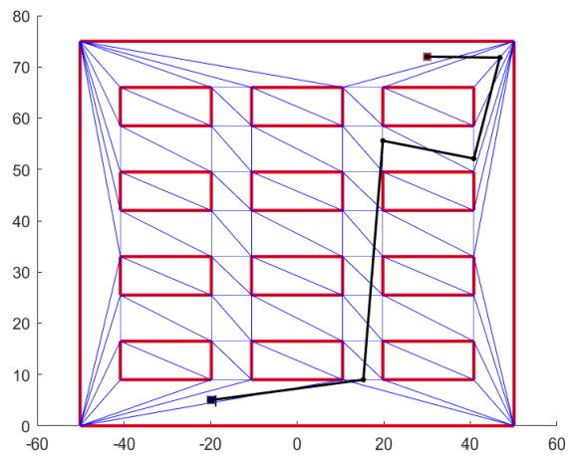

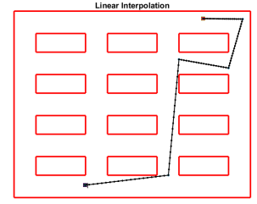
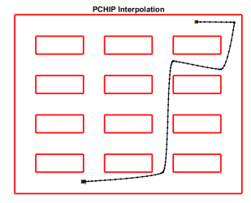
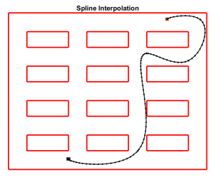
Trajectory generation
Continuous function
First derivative is not continuous
Continuous function
First derivative continuous
Second derivative is not continuous
Avoids overshooting
Continuous function
First and second derivative are also continuous
Too much overshooting
2024 October | Slide 7

Slide 8
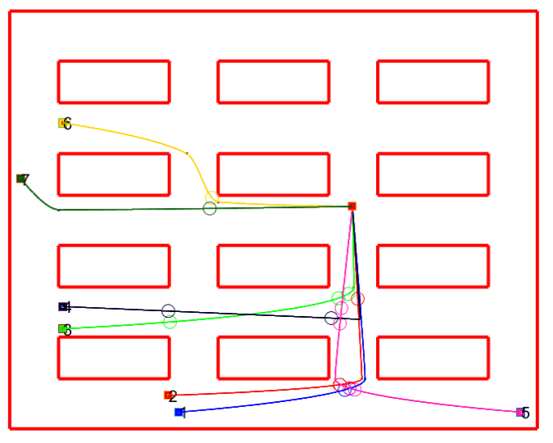
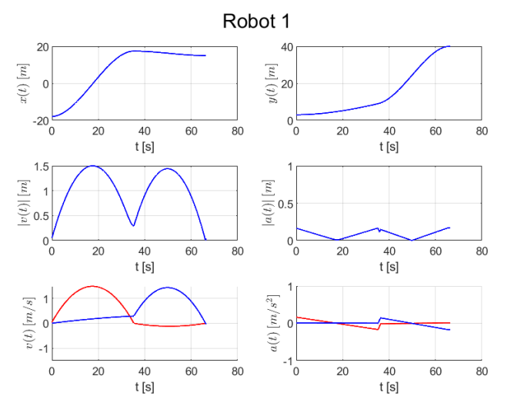
Trajectory generation
2024 October | Slide 8

Slide 9
Proposed approaches
Brute-force approach
Prioritized planning
Optimization approach (MINLP + GA)
Maximum velocities
Slow-down segment
Multi-objective (time+energy)
2024 October | Slide 9

Slide 10


Brute-force
Get all the possible combinations of maximum velocities
Find the best collision-free combination among them
Can use a minimum velocity to decrease significantly the number of combinations:
The criteria for choosing the best velocity combination is the minimization of:
2024 October | Slide 10

Slide 11
Prioritized planning
Plan trajectories starting from the robot with the highest priority at maximum velocity
Plan the remaining trajectories by scaling the maximum velocity to avoid collision with the robots with higher priority
Very fast execution times but poor results based on the choice of the heuristics
2024 October | Slide 11

Slide 12
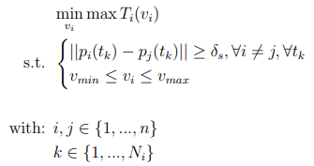
Optimization approach: MINLP + GA
Maximum velocities optimization
To overcome the limitations of the brute-force approach and prioritize planning, an approach that directly optimizes the maximum velocities of each robot’s trajectory was implemented
The optimization objective is to minimize the total travel time, which is defined as the time taken for the last robot to reach the goal. At the same time, collision avoidance is guaranteed by setting constraints that prevent robots from occupying the same space at the same time.
2024 October | Slide 12

Slide 13
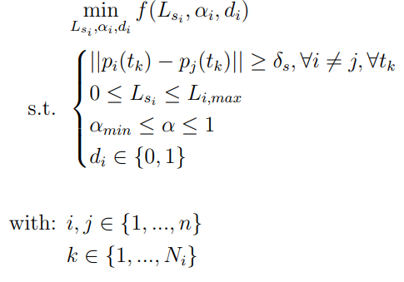

Optimization approach: MINLP + GA
Slow-down segment optimization
This method focuses on strategically slowing down robots only during the initial part of their paths to prevent collisions, while allowing them to operate at their maximum allowable velocities for the rest of their trajectories
2024 October | Slide 13

Slide 14
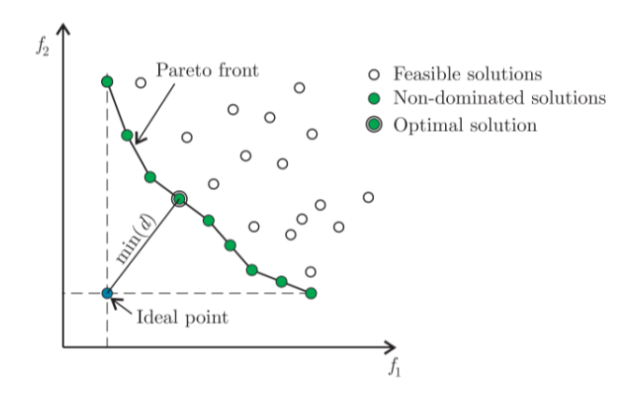
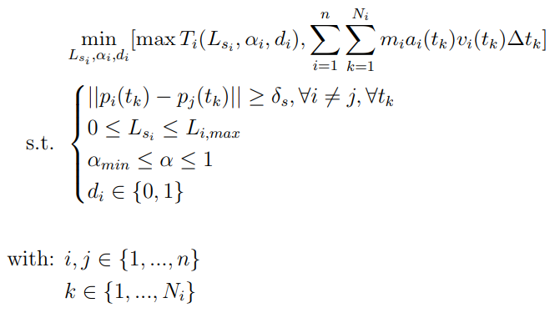
Optimization approach: MINLP + GA
Multi-objective optimization
Natural trade-off: optimizing for speed tends to increase energy consumption, while optimizing for energy efficiency tends to lengthen the completion time.
f1
f2
2024 October | Slide 14

Slide 15
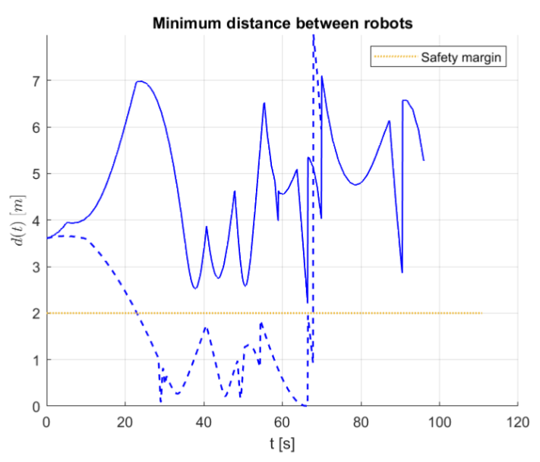
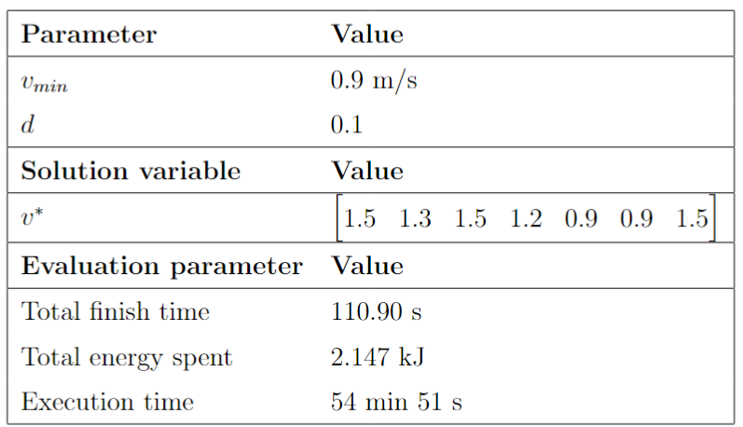
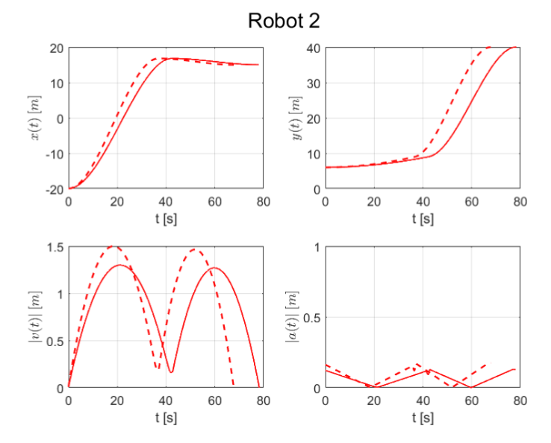

Simulation results:
Brute-force approach

Slide 16
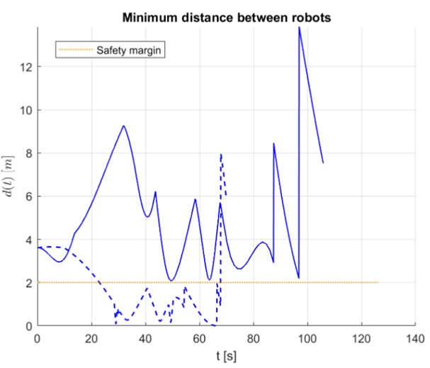
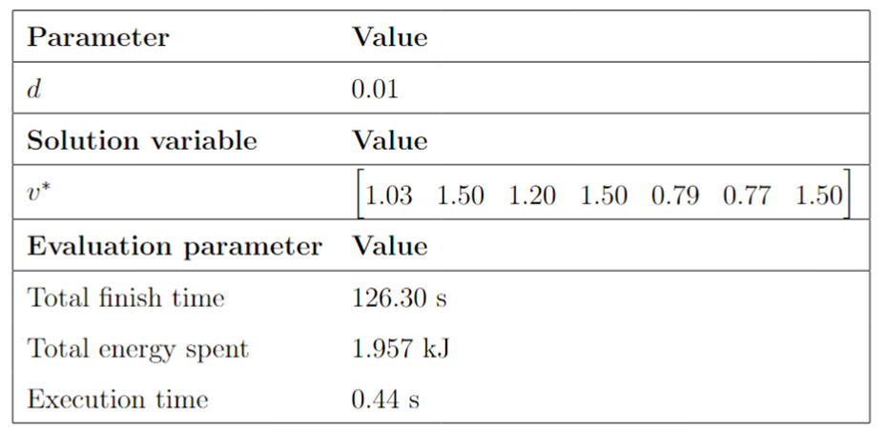
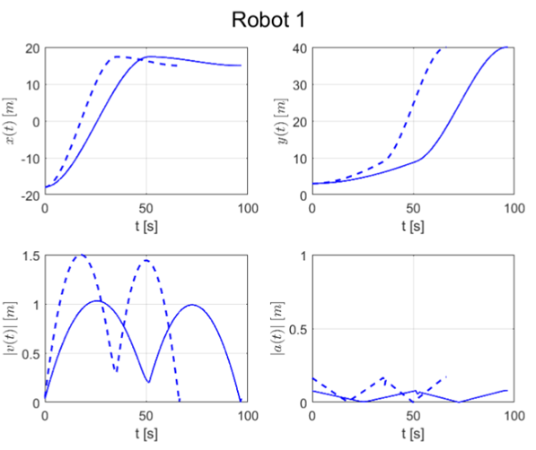
Simulation results:
Prioritized planning

Slide 17
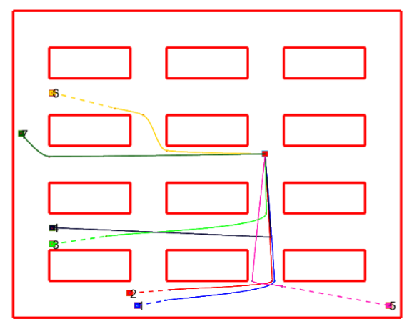
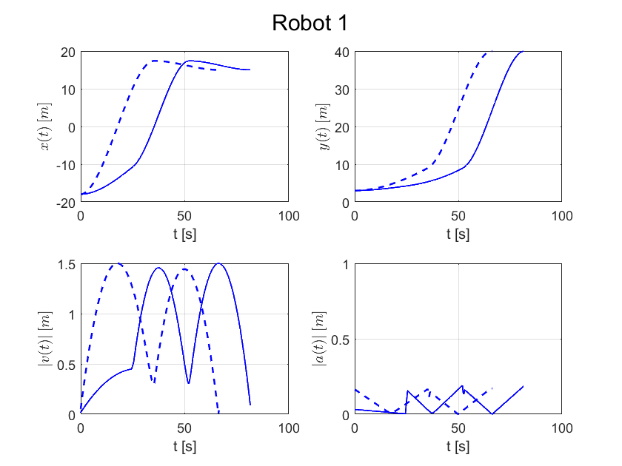
Simulation results:
Slow-down segment - Effect on the trajectories

Slide 18
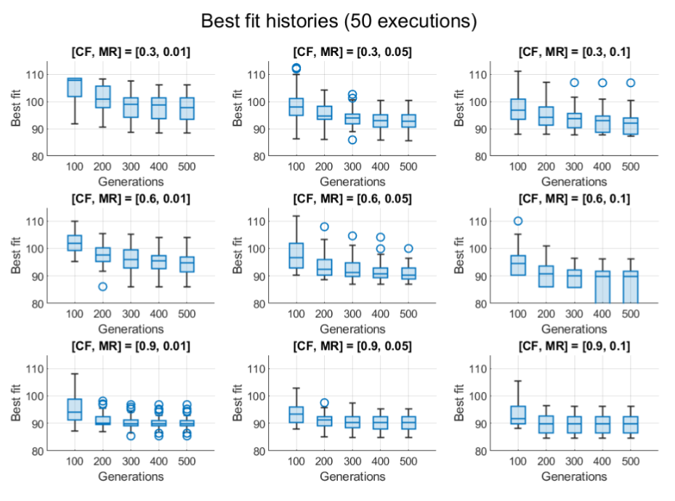
Simulation results:
Slow-down segment – Parameters selection
Population size: 100

Slide 19
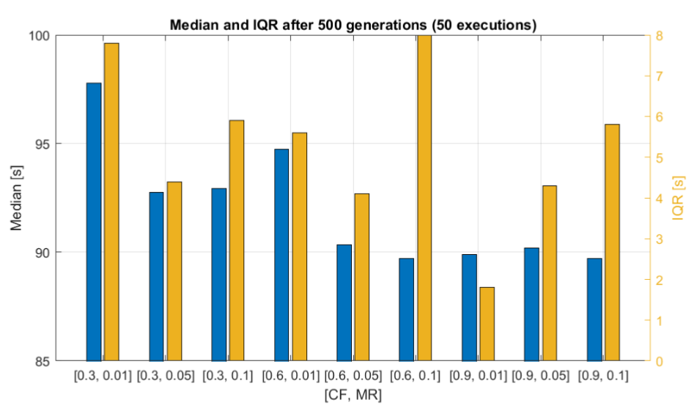
Simulation results:
Slow-down segment – Parameters selection

Slide 20
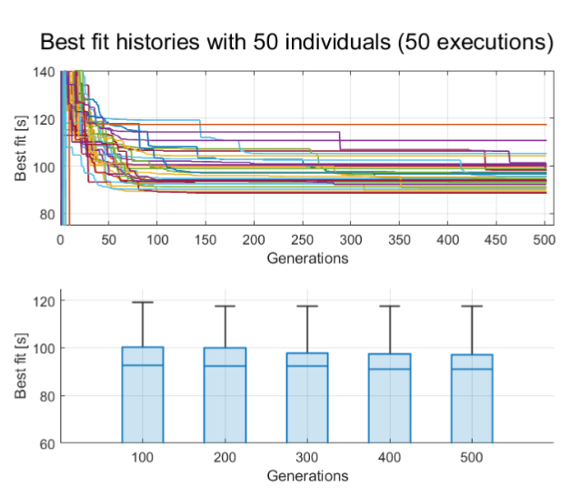
Simulation results:
Slow-down segment – Population size selection

Slide 21
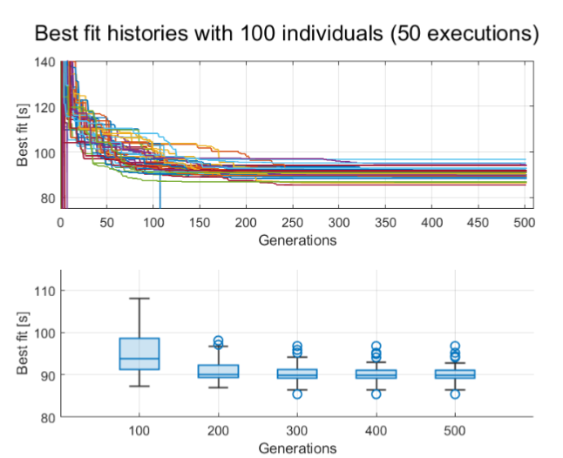
Simulation results:
Slow-down segment – Population size selection

Slide 22
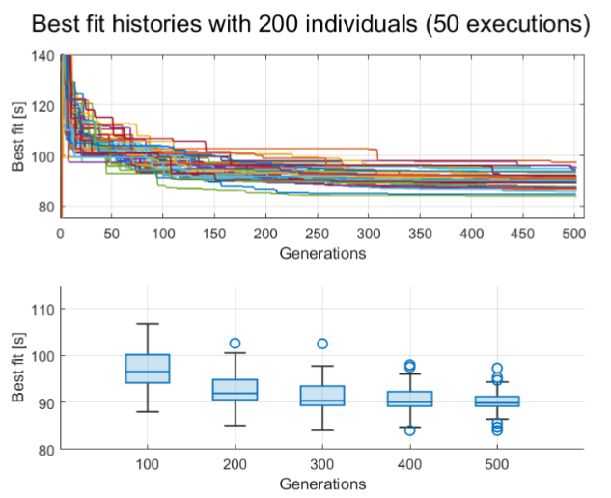
Simulation results:
Slow-down segment – Population size selection

Slide 23
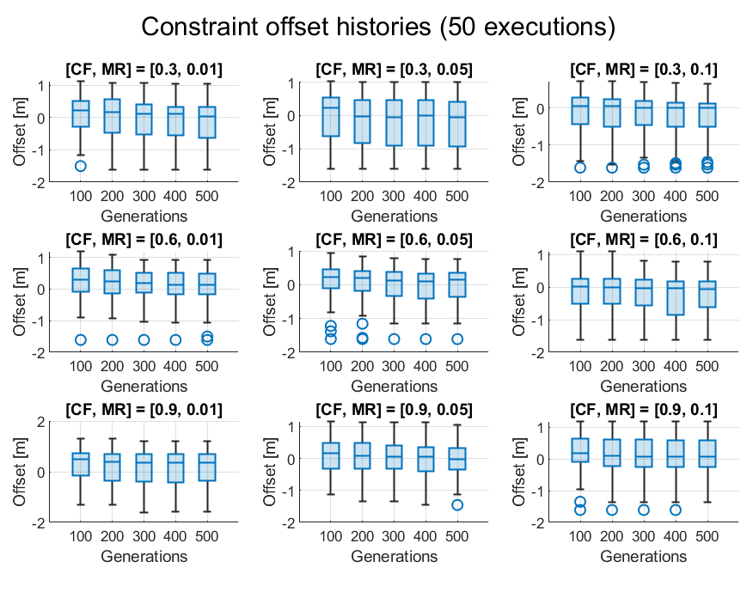
Simulation results:
Maximum velocities – Parameters selection
Population size: 100
Mutation: Uniform

Slide 24
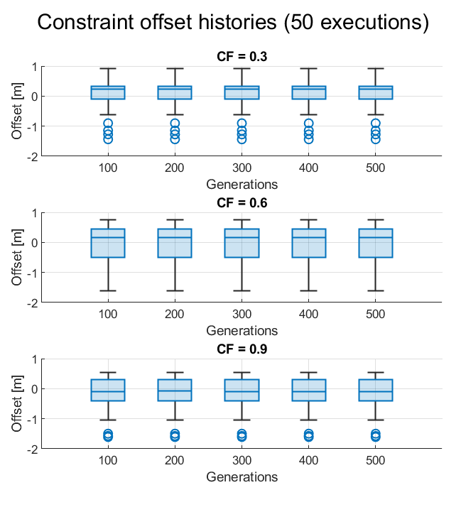
Simulation results:
Maximum velocities – Parameters selection
Population size: 100 Mutation: Self-adaptive

Slide 25
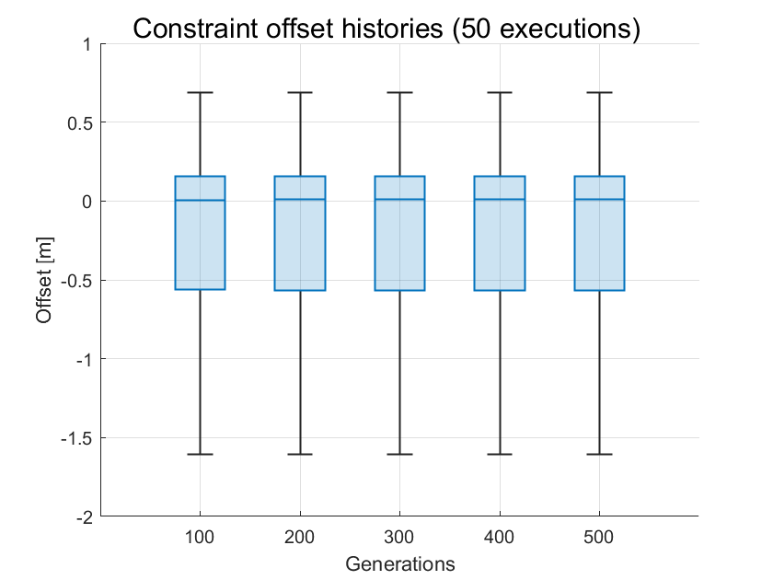
Simulation results:
Maximum velocities – Parameters selection
Population size: 1000 Mutation: Self-adaptive

Slide 26
Future work
Add the simulation results of the maximum velocities approach to the report
Produce simulations with the constraint offset for the slow-down segment approach
Produce and analyze simulations for the multi-objective optimization

